Slide 1
Isotopes.au Team Meeting
CSIRO & ANSTO & GA & Lithodat

Slide 2

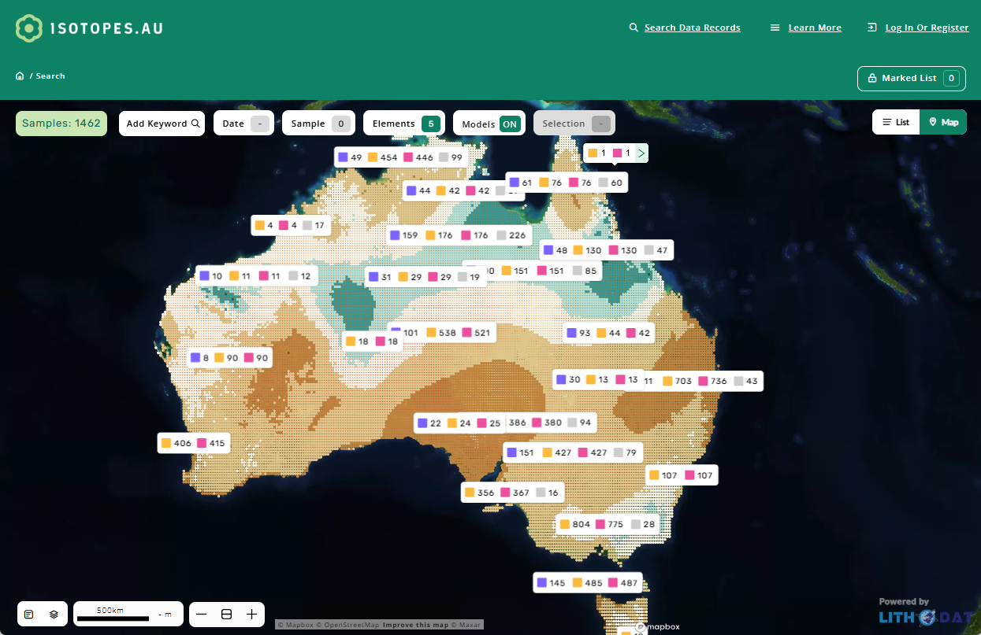
isotopes.au is live!

Slide 3
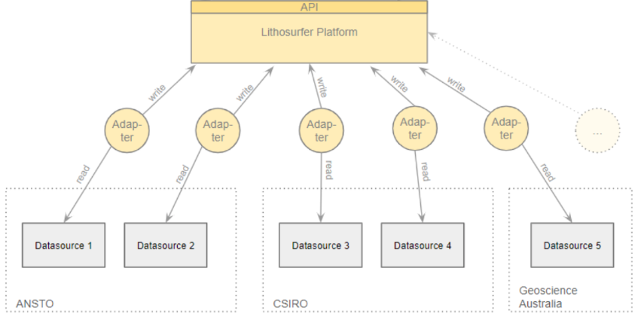
Working Model & Adapters is Basis for UI
UI
Model & Adapters
This presentation focuses on the Model & Adapter development

Slide 4
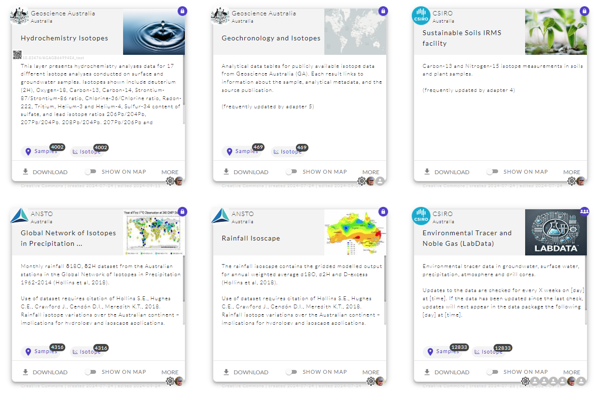
Current State of Adapters
Used in Production
Completed
This one is new since last time.

Slide 5
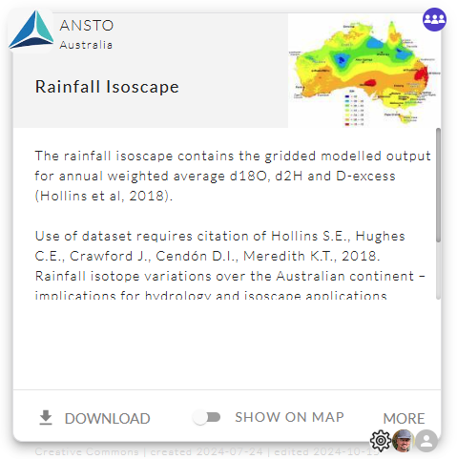

State of Adapter 1
13 of 13 SPECIFIED Mappings IMPLEMENTED
0 of 13 IMPLEMENTED Mappings APPROVED
Visibility: PUBLIC on TEST
Automatic Updates: No

Slide 6
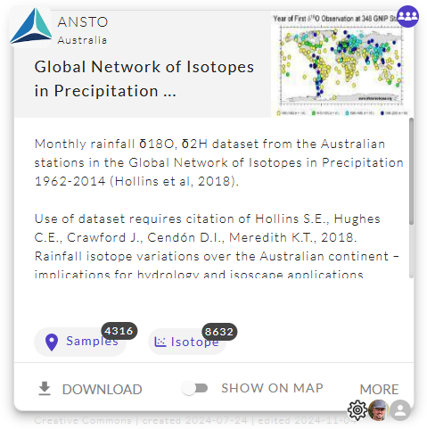
State of Adapter 2
17 of 17 SPECIFIED Mappings IMPLEMENTED
13 of 17 IMPLEMENTED Mappings APPROVED
Visibility: PUBLIC on TEST
Automatic Updates: No
Experts: Cath + Jagoda
link

Slide 7
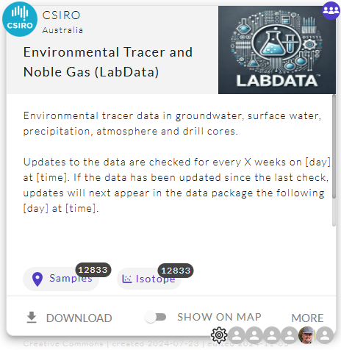
State of Adapter 3
32 of 32 SPECIFIED Mappings IMPLEMENTED
13 of 32 IMPLEMENTED Mappings APPROVED
Visibility: PUBLIC on TEST
Automatic Updates: Yes
Experts:
Christoph + Axel

Slide 8
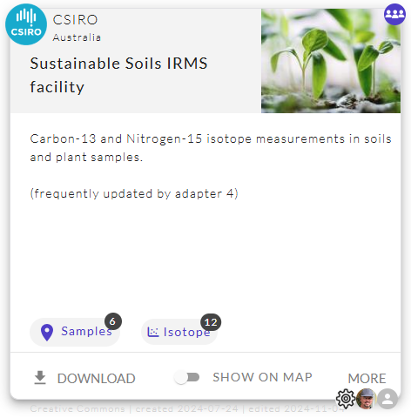
State of Adapter 4
18 of 49 SPECIFIED Mappings IMPLEMENTED
0 of 18 IMPLEMENTED Mappings APPROVED
Visibility: PUBLIC on TEST
Automatic Updates: No
Experts:
Nina + Steve

Slide 9
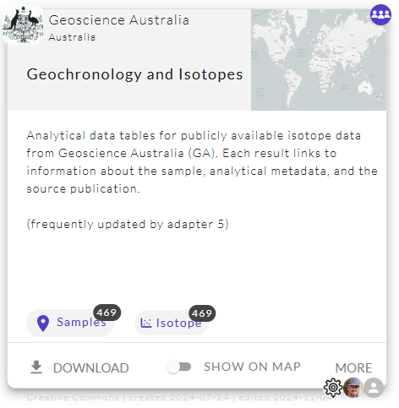
State of Adapter 5
18 of 22 SPECIFIED Mappings IMPLEMENTED
15 of 18 IMPLEMENTED Mappings APPROVED
Visibility: PUBLIC on TEST
Automatic Updates: Yes
Experts:
Steph + Geoff

Slide 10
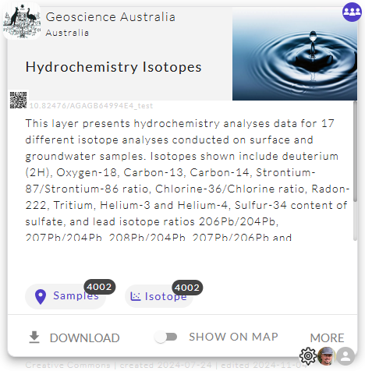
State of Adapter 6
24 of 24 SPECIFIED Mappings IMPLEMENTED
23 of 24 IMPLEMENTED Mappings APPROVED
Visibility: PUBLIC on TEST
Automatic Updates: Yes
Experts:
Steph + Geoff

Slide 11
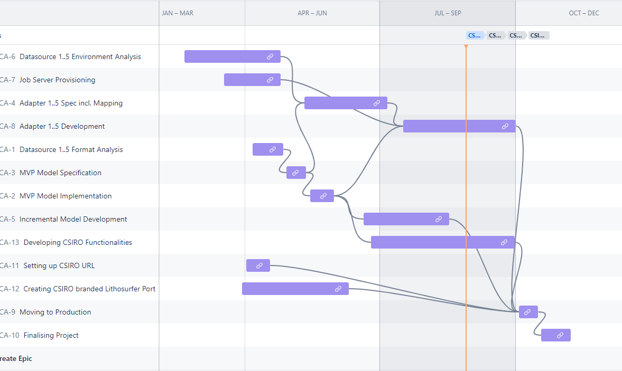
Lithodat internal Timeline
Round 1
Round 2
Round 3
Round 4

Slide 12
Thanks!

Slide 13



Next Step: Round 4
isotopes.au ontology
compares
Lithodat
Lithodat ending round 3 by creating and running new version of adapters.
(till Monday 11th with version 0.4.4)
Expert
isotope.au experts starting round 4 by comparing source with export files (v0.4.4).

Slide 14
Process of Approving the Adapters
We are entering Round 4 on Monday coming week. Probably the last Round before going productive.
To approve a field mapping the proprietary input data has to be checked against the output data in common ontology format.
How to check the mappings:
Download the latest ontology.xls of your adapter.
Pick a random row from your proprietary.xls
Find the corresponding row in the ontology.xls.
Check the mappings.
Repeat with other row if unsure.
Update ontology definition sheet
Ansto.ontology.xls
Ansto.proprietary.xls

Slide 15
Enable filtering by type on the UI

Slide 16
How to Approve
To approve a field mapping the proprietary input data has to be checked against the output data in common ontology format.

Slide 17
How to Approve
To approve a field mapping the proprietary input data has to be checked against the output data in common ontology format.
The proprietary input data gets translated (aka. mapped).
Ansto.proprietary.xls

Slide 18
How to Approve
To approve a field mapping the proprietary input data has to be checked against the output data in common ontology format.
CLICK on DOWNLOAD
Ansto.ontology.xls
The data get’s exported in the format of the common ontology.
Ansto.proprietary.xls

Slide 19

How to Approve
To approve a field mapping the proprietary input data has to be checked against the output data in common ontology format.
But how can the data be checked?
Ansto.ontology.xls
Ansto.proprietary.xls

Slide 20
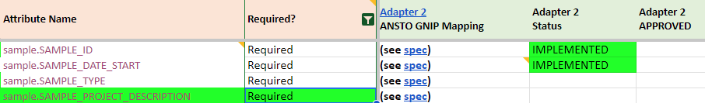
Definition of “Ready for Production”
All required fields need to have been approved by an expert.
by Cath
by Cath
Ontology definition sheet
Leave a comment instead of your name in case the mapping is not as expected.

Slide 21
Full Cycle
To approve a field mapping the proprietary input data has to be checked against the output data in common ontology format.
The data get’s exported in the format of the common ontology.
CLICK on DOWNLOAD
Ansto.ontology.xls
The proprietary input data gets translated (aka. mapped).
Ansto.proprietary.xls

Slide 22
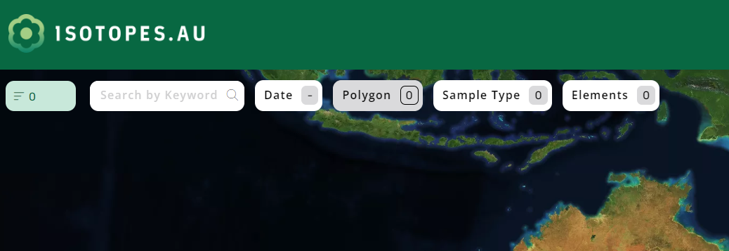
Overview of filters
!

Slide 23
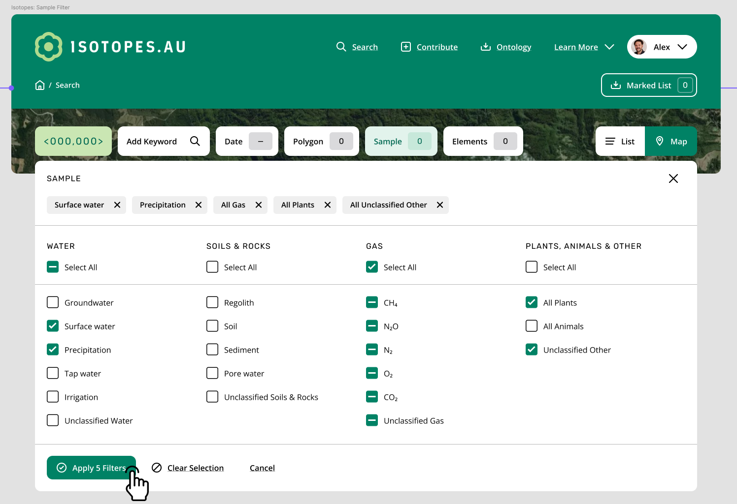
UI as specified by CSIRO (2024-09-16)
See concept

Slide 24
Main Goal of Today’s Meeting:
Understanding the Adapter Development Process
The adapters need to implement a lot of expert knowledge. Next slides will show with a concrete example how the knowledge can be transferred from the experts to the developers.

Slide 25

Overview
isotopes.au ontology
Speci- fication

Slide 26
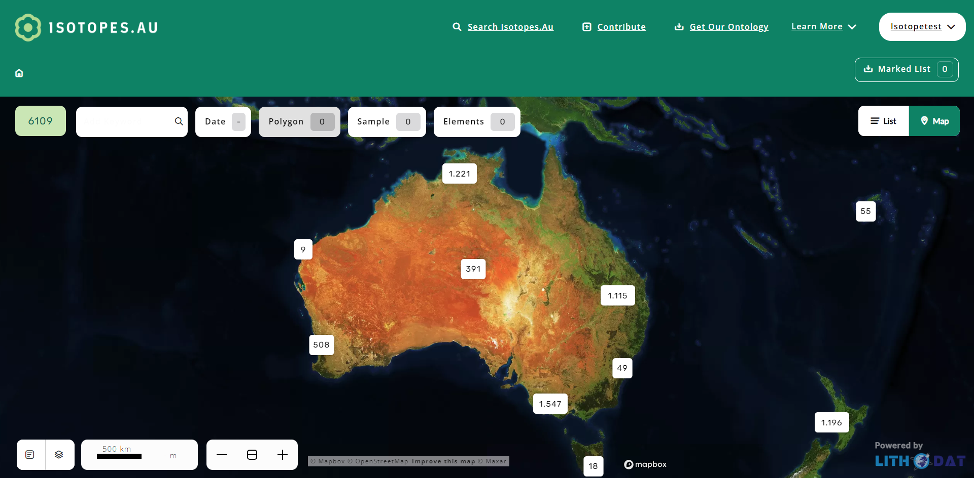
Speci- fication

Slide 27
Overview
Speci- fication
Technicals
Mappings

Slide 28
Overview
reads
Speci- fication
Coder
implements
Coder releases version when finished.

Slide 29
isotopes.au ontology
updates
compares
Speci- fication
Expert

Slide 30


isotopes.au ontology
updates
compares
Speci- fication
Expert
reports issue
Lian F.
Bug-
tracker

Slide 31
Overview
reads
Speci- fication
Coder
implements
reads
Bug-
tracker

Slide 32
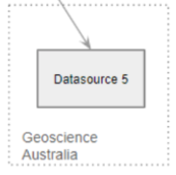
Let’s Exercise an Expert Feedback Round
What the expert needs:
Expert
isotopes.au ontology
output
Speci- fication

Slide 33
Let’s Exercise an Expert Feedback Round
How to update the spec:
feedback
Lian
edits
Expert
comments
isotopes.au ontology
output
Speci- fication

Slide 34
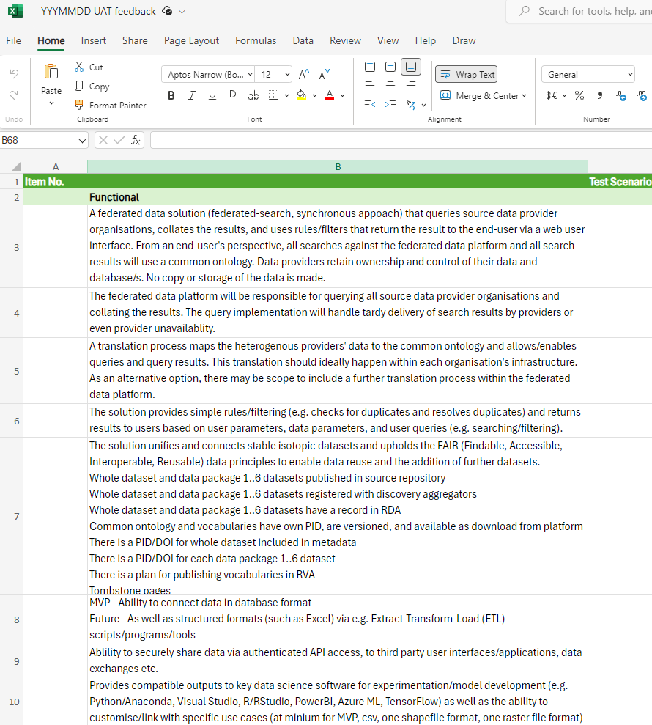
Feedback Formular

Slide 35
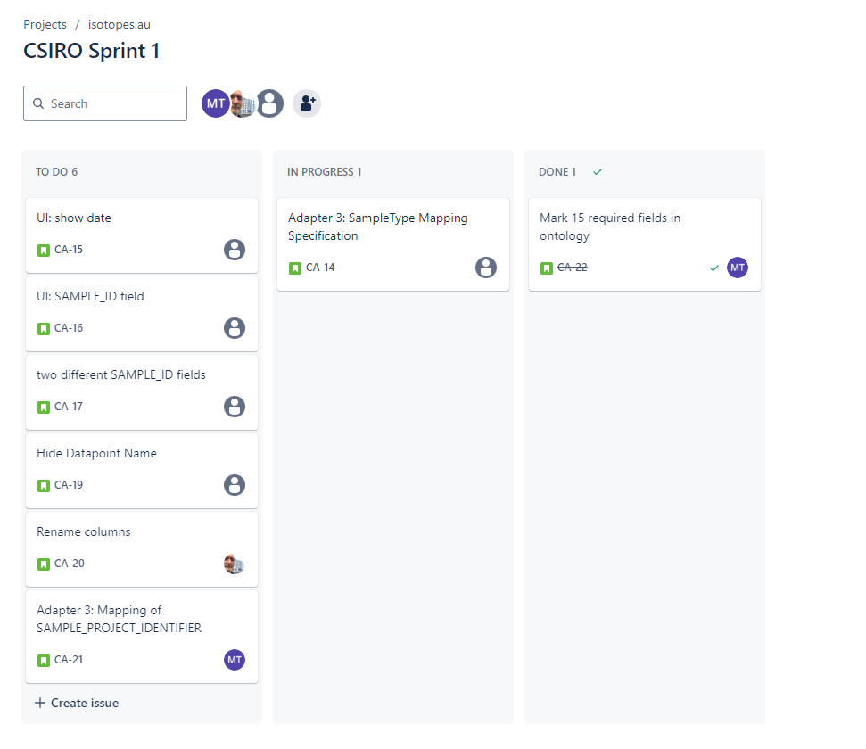
All Feedback and Issues can be managed in Jira

Slide 36
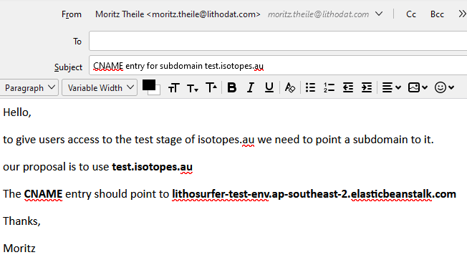
Send Mails with instructions
Who are the recipients?

